Slide 1
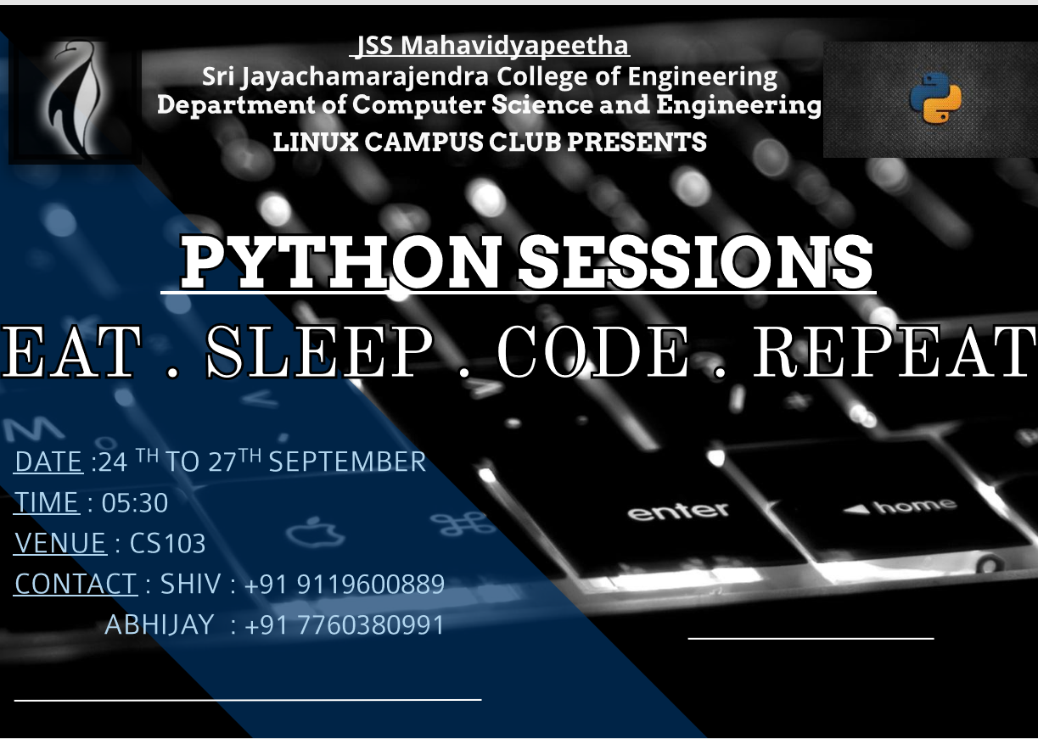

Slide 2
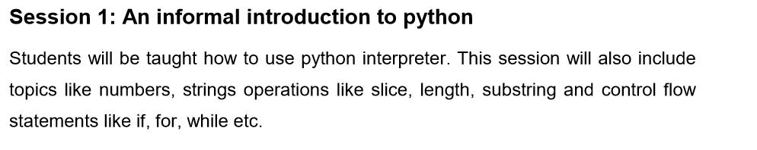
INTRODUCTION
TO PYTHON

Slide 3
Python is a powerful high-level, object-oriented programming language created by Guido van Rossum.
Python is a general-purpose language. It has wide range of applications from Web development (like: Django and Bottle), scientific and mathematical computing (Orange, SymPy, NumPy) to desktop graphical user Interfaces (Pygame, Panda3D).
Features of Python Programming
A simple language which is easier to learn. Python has a very simple and elegant syntax. ...
Free and open-source. ...
Portability. ...
Extensible and Embeddable. ...
A high-level, interpreted language. ...
Large standard libraries to solve common tasks. ...
Object-oriented.

Slide 4
Few Important Things to Remember
To represent a statement in Python, newline (enter) is used. The use of semicolon at the end of the statement is optional
(unlike languages like C/C++, PHP). In fact, it's recommended to omit semicolon at the end of the statement in Python.
Instead of curly braces { }, indentations are used to represent a block.
Generally four whitespaces are used for indentation and is preferred over tabs. Here is an example.
im_a_parent:
im_a_child:
im_a_grand_child
im_another_child:
im_another_grand_child

Slide 5
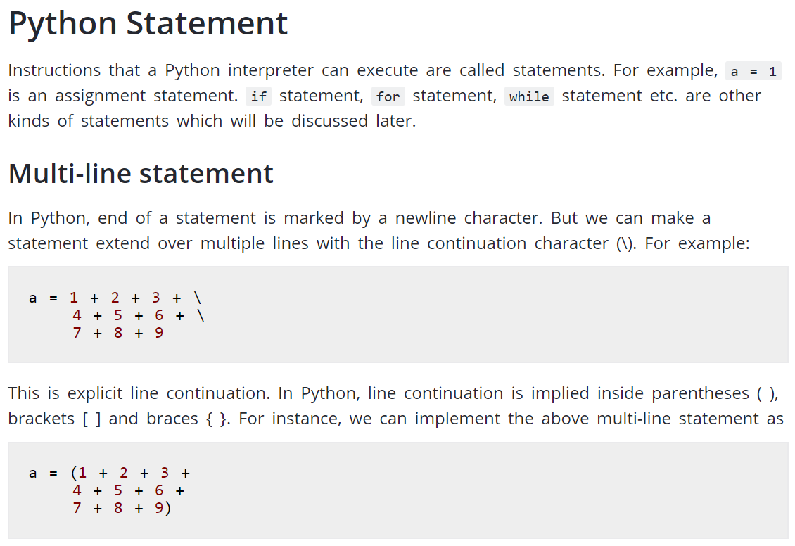

Slide 6
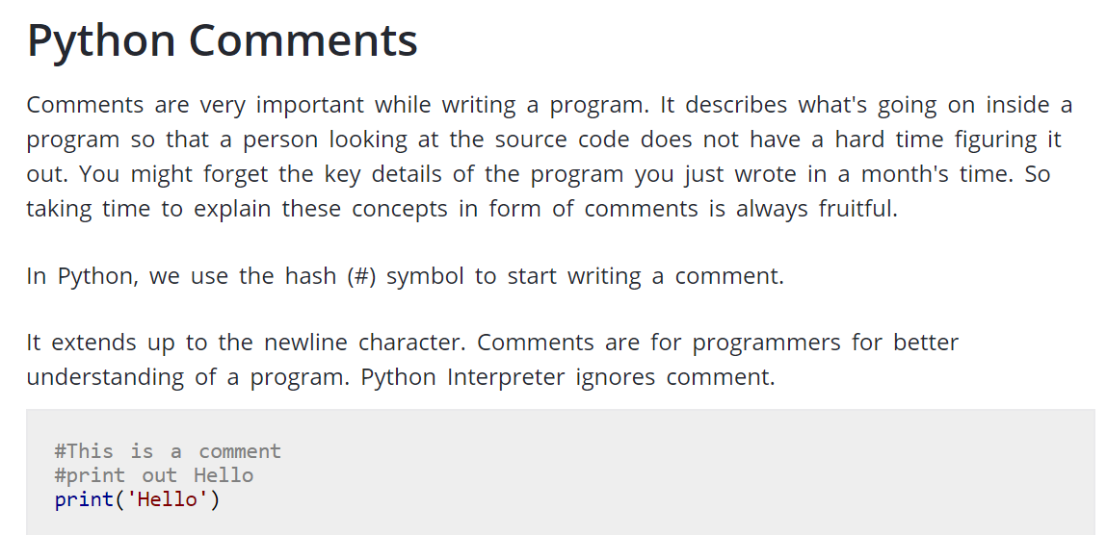

Slide 7
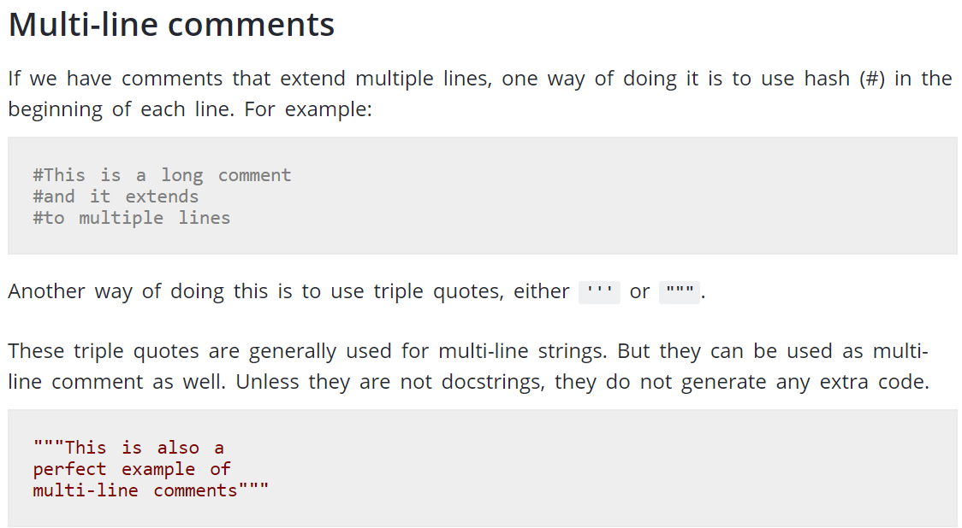
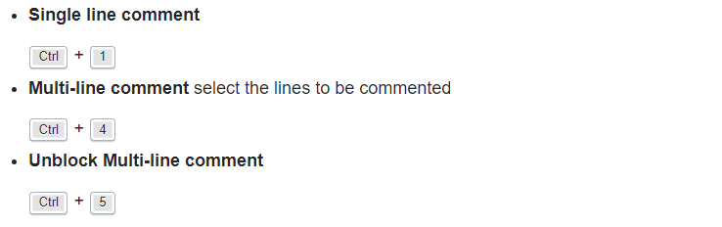

Slide 8
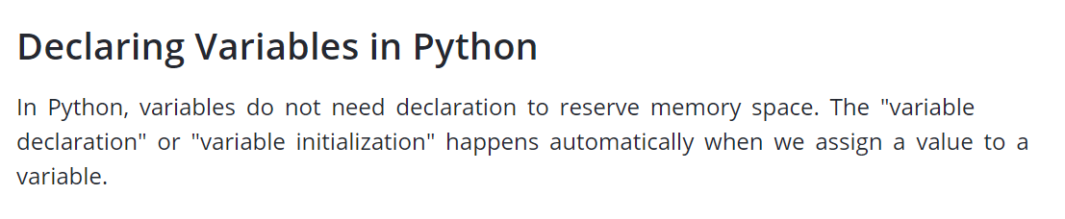
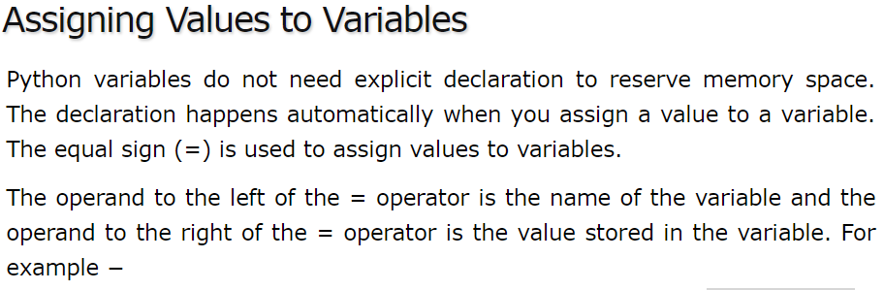
X=14
Y=‘hello’
Z=“student’s”
print(x)
print(y)
print(z)
Here,the function print is used to display the value of x on output screen

Slide 9
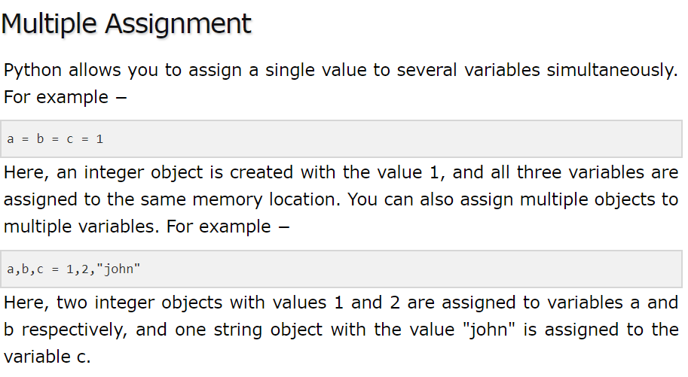

Slide 10
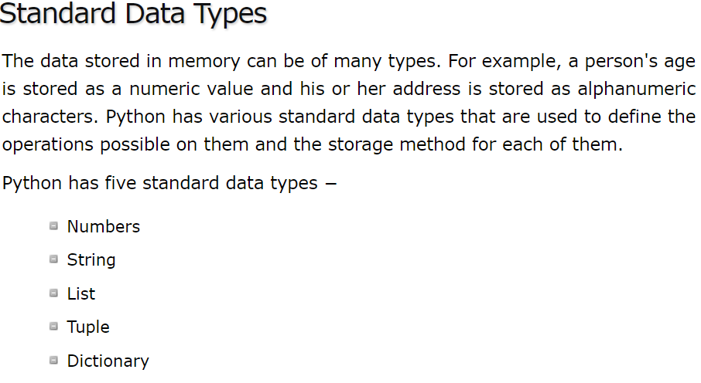
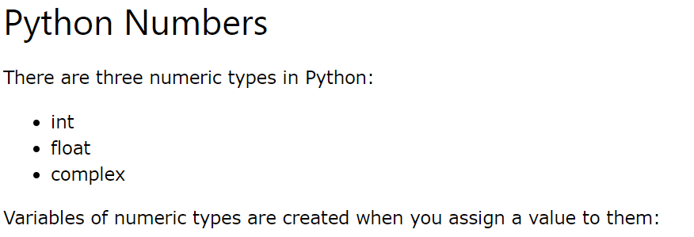

Slide 11
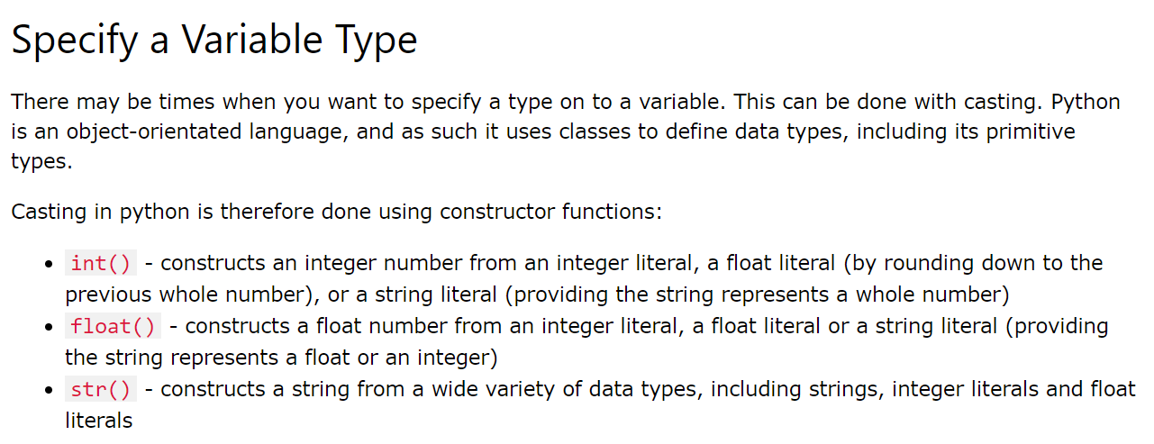

Slide 12
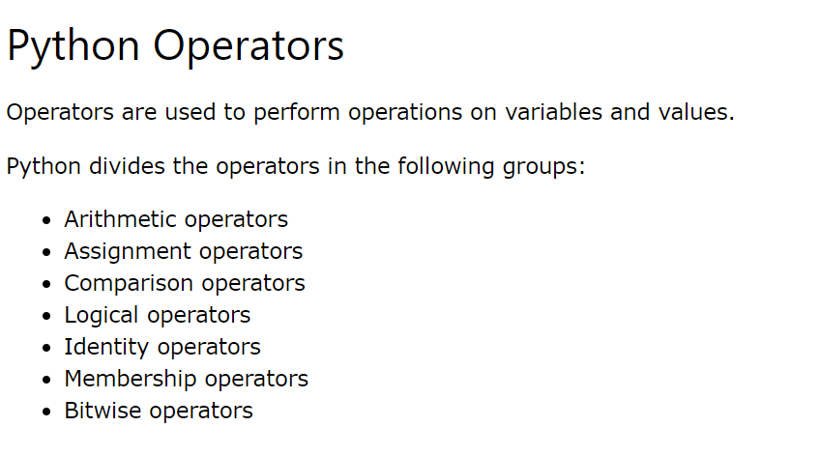

Slide 13
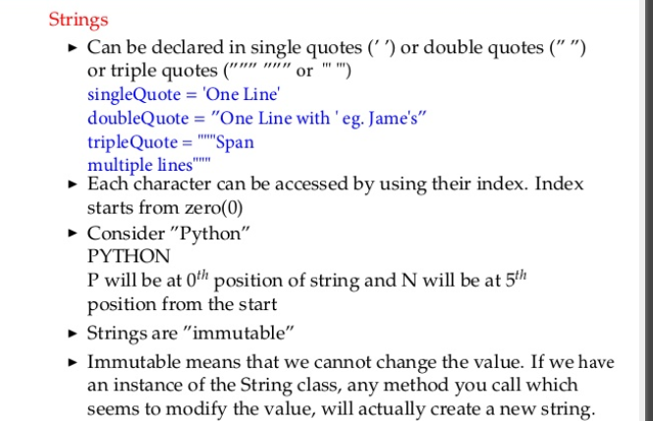

Slide 14
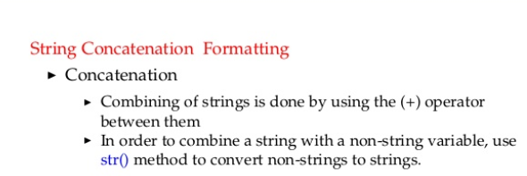
Reading Strings
Var = input(“Enter the String \n”)
Printing Strings
print (“Hello world”)
print (‘Hello world’)
print (“ \”python\” ”) // output: “python”
print (“ ”python” ”) // error

Slide 15
Examples:
print (“Hello” + “ world”)
print (“Hello ” , ”world”)
//output: Hello world
Var=“Hello ”+str(123)
//output: Hello 123

Slide 16
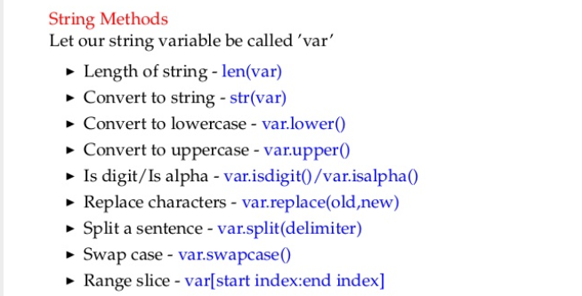
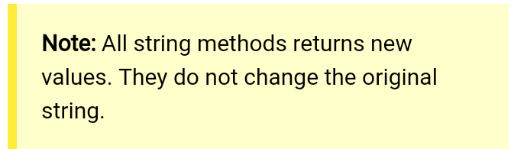

Slide 17
Examples:
Var= “python”
print ( Var.upper() ) //output: PYTHON
Var = “cat,dog,owl”
print ( Var.split(‘,’) ) // output: [‘cat’ , ’dog’ , ’owl’]
Var=“Hello”
x=Var[1: ] // ello
y=Var[ :3] // Hell
z=Var[-2:] //lo -1 is the index for last character
Var= “ python ”
print ( Var.strip() ) // “python” (remove extra spaces)

Slide 18
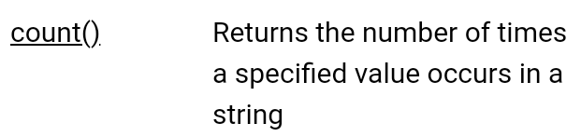
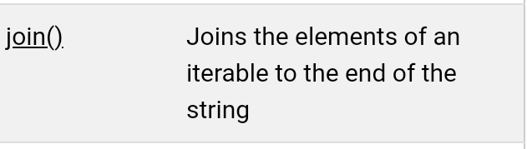
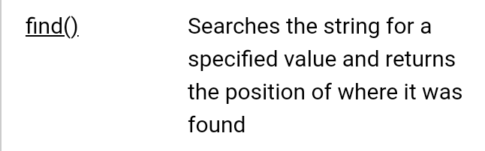
Few more string methods:
Var = “manage”
Var.count(‘a’)
// returns 2
“ - ”.join([‘co’,’ed’])
// co-ed
Var = “manage”
Var.find(‘a’)
//returns 1

Slide 19
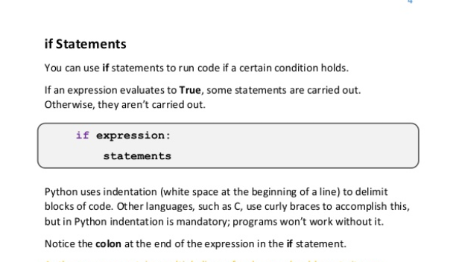
Conditional statements :
A statement that controls the flow of execution depending on some condition.
In Python the keywords if , elif , and else are used for conditional statements.

Slide 20
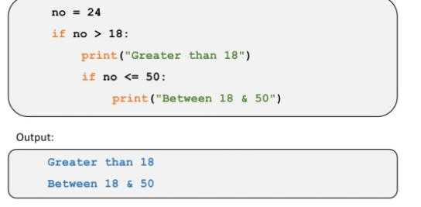
Example:

Slide 21
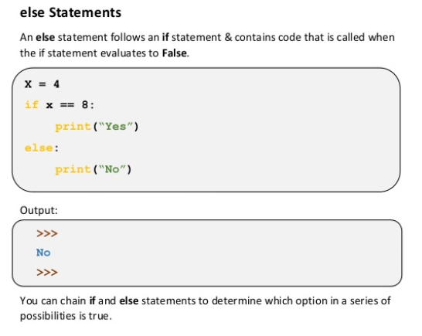

Slide 22
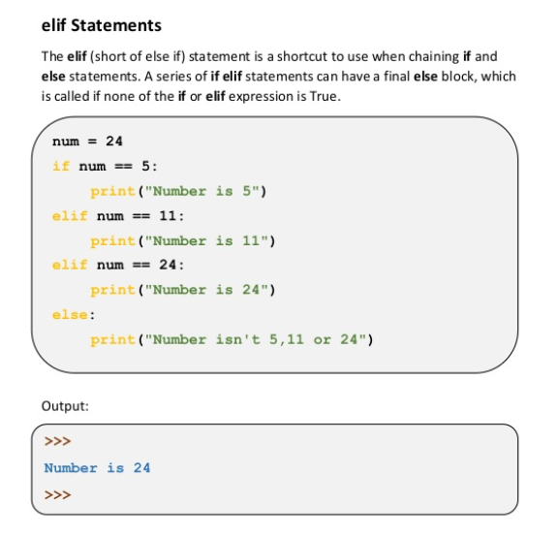

Slide 23
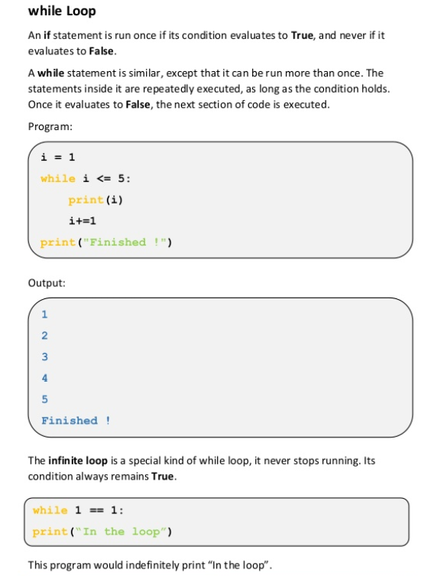
LOOPS:

Slide 24
FOR LOOP:
for condition :
statements
Ex:
for x in range(1:6)
print (x)
// 1 2 3 4 5

Slide 25
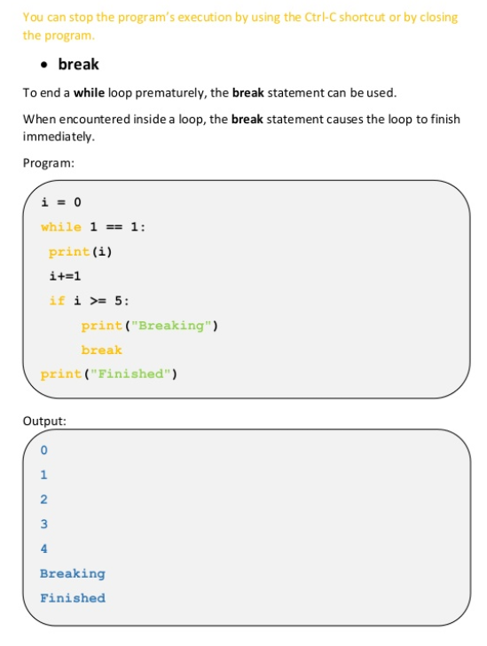

Slide 26
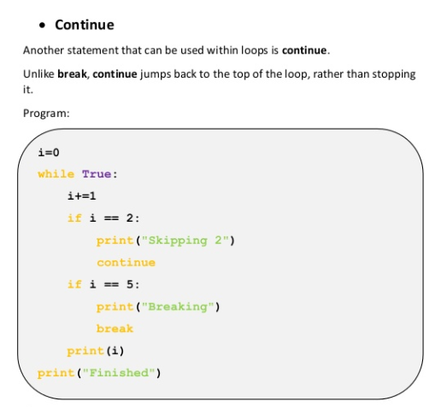
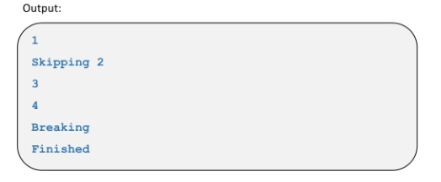

Slide 27
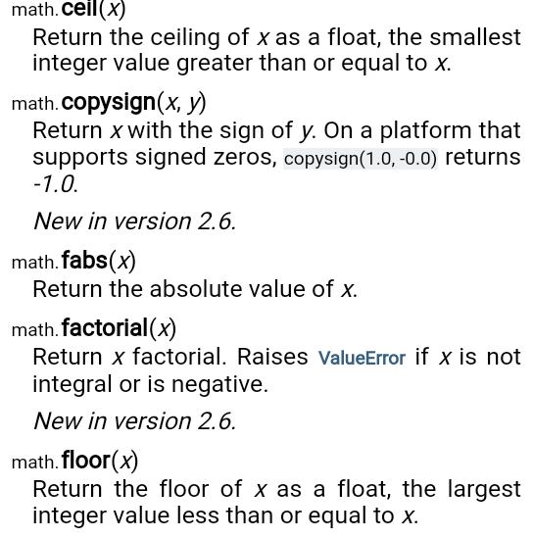
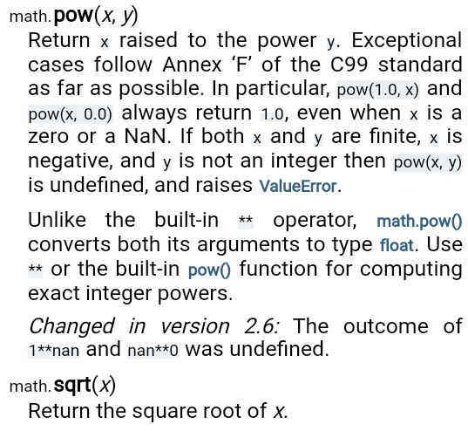
Math package:
import math

Slide 28

Fun with python:
Single line if-else : x if x>y: y (no ternary operator)
Print(3*”hello ” + “ world” ) //hello hello hello world
sys
var=sys.stdin.read()
sys.stdout.write(“ ”)
Os
basic linux commands.
ex: os.listdir(path) – lists the files in the directories.

Slide 29
Time
Getting current date and time:
localtime(time.time())
// output: Local current time :
time.struct_time(tm_year=2013, tm_mon=7, tm_mday=17, tm_hour=21, tm_min=26, tm_sec=3, tm_wday=2, tm_yday=198, tm_isdst=0)
time.asctime(time.localtime(time.time()) )
// output: Mon Sept 24 10:17:09 2018
Getting calendar:
calendar.month(2008,1)
January 2008
Mo Tu We Th Fr Sa Su
1 2 3 4 5 6 7
8 9 10 11 12 13 14
15 16 17 18 19 20 21
22 23 24 25 26 27 28
29 30 31

Slide 30


